Slide 1



IPL 2022
Auction Data Analysis
SUBMITTED TO - Dr. SOUMYA RANJAN MISHRA

Slide 2
1
Bastab Barik - 2105188
2
Suvra Mukherjee - 2105842
Members
3
Dipanjan Kamilla - 2105853
4
Shruti Dutta - 21051596
5
Sarthak Ghosh - 21052528

Slide 3
ABSTRACT
1
ACKNOWLEDGEMENT
2
3
INTRODUCTION
4
DATA COLLECTION
CONTENTS
5
EXPLORATORY DATA ANALYSIS
6
DATA PREPROCESSING
7
MODELS
GRAPH STUDY
8
CONCLUSION
9

Slide 4
01
01
The IPL (Indian Premier League) has become not just a cricketing extravaganza but also a platform where data-driven decisions can significantly impact team performance. The IPL 2022 Auction Data Analysis project aims to explore and analyze the data from the IPL 2022 auction using Python, unraveling insights into player valuation trends, team strategies, and factors influencing player prices.Through meticulous data collection from official IPL sources or reliable datasets, we delve into the player attributes, base prices, sold prices, and other pertinent information. Employing Python's powerful libraries for data analysis, visualization, and modeling, we conduct exploratory data analysis (EDA) to uncover patterns, distributions, and correlations within the data.
Abstract
02
Our analysis extends to historical trends, comparing auction dynamics with 2022 seasons to identify shifts and patterns. We delve deeper into factors influencing player base prices, sold prices , playing role, and team strategies.Optionally, predictive modeling using python allows us to forecast player prices, offering insights into potential player valuations for future auctions. Our findings culminate in actionable insights and strategic recom mendations for IPL teams, aiding them in making informed decisions during the auction process.This project not only showcases the prowess of Python in analyzing sports data but also underscores the importance of data-driven decision-making in the highly competitive realm of professional sports. Through this analysis, we aim to contribute to the evolving landscape of sports analytics, offering valuable insights for IPL team management and stakeholders.

Slide 5
02
ACKNOWLEDGEMENT
We gratefully acknowledge the collective contributions that have enriched the field of IPL 2022 auction data analysis. Our appreciation extends to the pioneering researchers whose work has shaped the landscape of sentiment analysis methodologies. We express our gratitude to our teacher, technical assistant and classmates for their guidance and inspiration, which have been invaluable in our exploration of ipl 2022 auction data analysis. It is through the collective efforts of these individuals and organizations that we continue to advance our understanding of public opinion and discourse in the digital age.

Slide 6
03
OBJECTIVE
A
INTRODUCTION
IMPORTANCE.
B
APPROACH
C

Slide 7
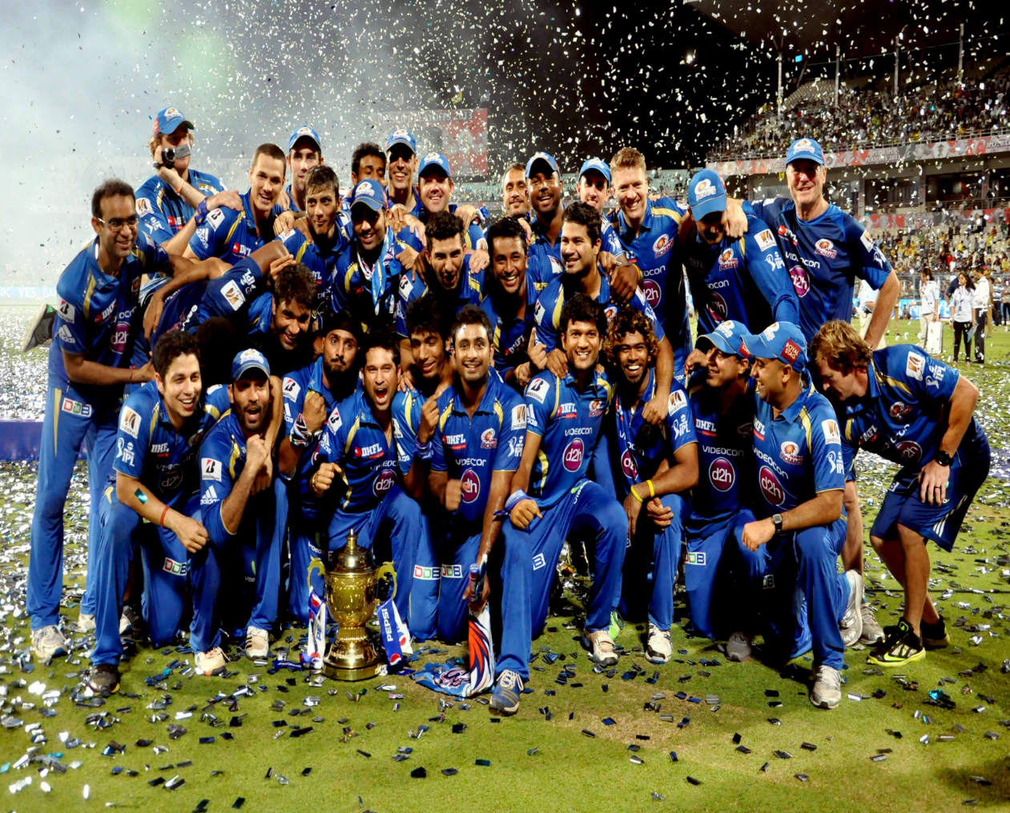
03
INTRODUCTION
A
The IPL 2022 Auction Data Analysis project sets out to delve into the intricacies of the IPL auction process using Python, with the primary objective of uncovering valuable insights to aid teams in making informed decisions during player auctions. Through rigorous data analysis, we aim to identify trends, patterns, and key factors influencing player valuations, ultimately contributing to the strategic planning and success of IPL franchises.
B
In the fiercely competitive landscape of professional cricket, the IPL auction serves as a pivotal event where teams vie for the best talent to assemble winning squads. In this context, data-driven decision-making becomes imperative for gaining a competitive edge. By analyzing auction data, we can gain deeper insights into player valuations, market dynamics, and team strategies, empowering franchises to optimize their resources and maximize their chances of success on the field.
C
Leveraging the versatility and power of Python, our approach involves comprehensive data collection, preprocessing, exploratory data analysis (EDA), and potentially, predictive modeling. Through a combination of statistical analysis and visualization techniques, we aim to unravel the underlying patterns within the auction data, ranging from player demographics to bidding strategies. By adopting a systematic and iterative approach, we endeavor to extract actionable insights that can inform decision-making processes and drive strategic outcomes in the high-stakes environment of the IPL auction.

Slide 8
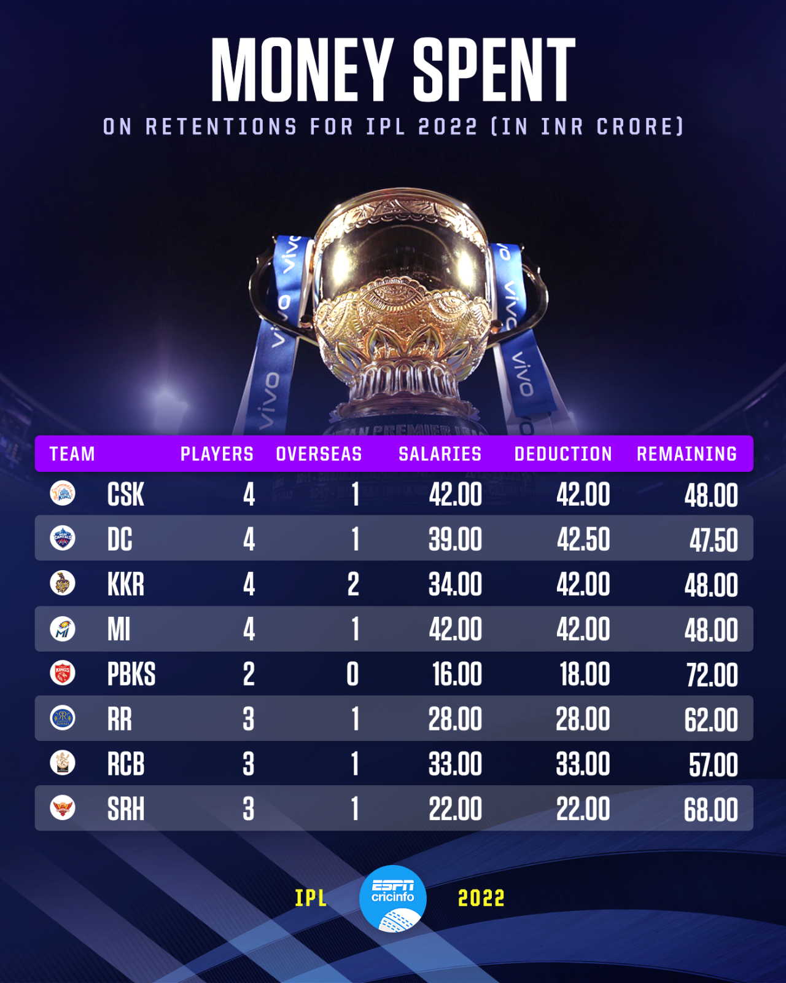
04
DATA COLLECTION
Source:
The data for this project was sourced from official IPL repositories, ensuring authenticity and reliability. We accessed comprehensive datasets encompassing player profiles, auction details, team rosters, and other pertinent information directly from the IPL governing body.
Data Set Overview:
The dataset comprises a rich repository of information encapsulating the IPL 2022 auction, including player attributes, base prices, sold prices, team affiliations, nationality, playing roles, and performance metrics. With a granular level of detail, the dataset allows for thorough analysis and exploration of various facets of the auction process.
Quality Assurance:
Ensuring data quality and integrity was paramount throughout the data collection process. Rigorous quality assurance measures were implemented to address potential discrepancies and inconsistencies within the dataset. This involved thorough validation checks, data cleansing procedures, and verification against official IPL sources to mitigate errors and ensure the accuracy and reliability of the data. By adhering to strict quality assurance protocols, we have instilled confidence in the integrity of the dataset, laying a solid foundation for subsequent analysis and insights generation.

Slide 9
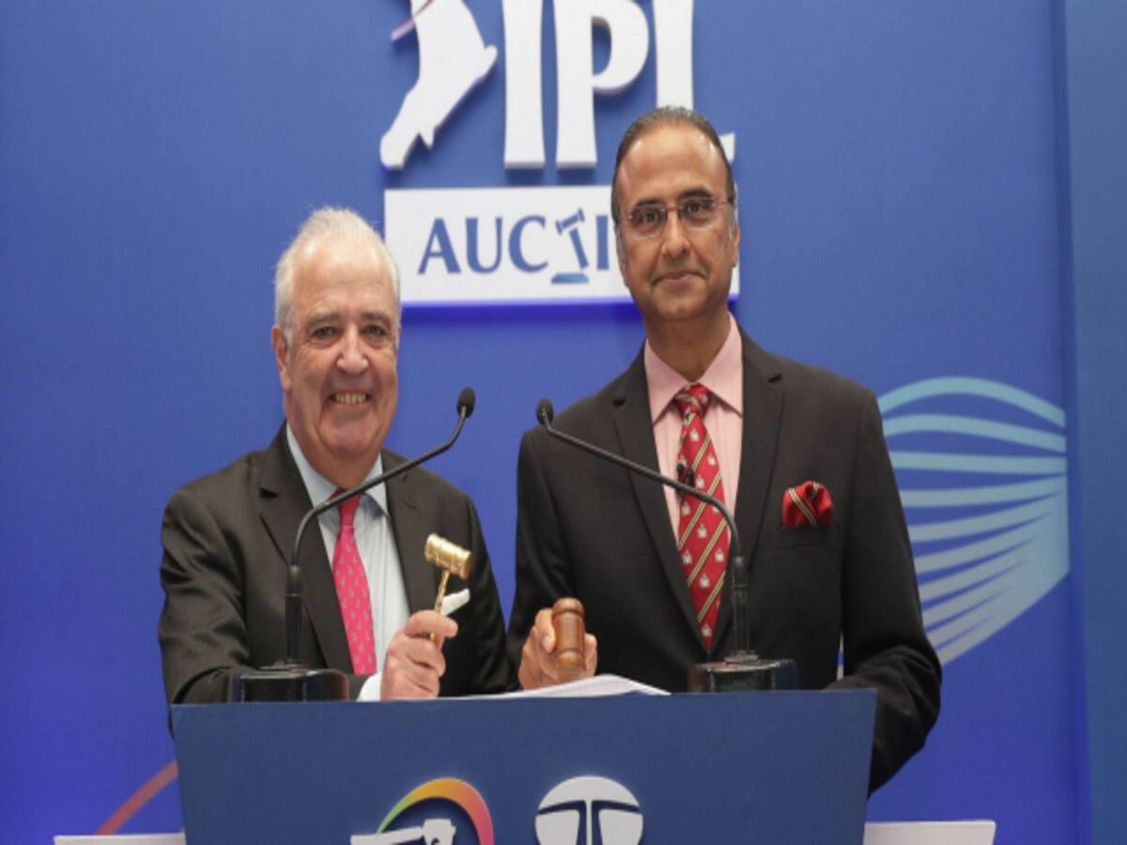
06
DATA PREPROCESSING
Loading the ipl 2022 auction dataset for data preprocessing involves several steps to prepare the data for analysis. Initially, ensure you have downloaded the dataset from Kaggle and have it available in a format compatible with your programming environment. Then we follow these steps mentioned in the next slide.

Slide 10
04
DATA PREPROCESSING
4. PREPROCESSING STEPS
3. EXPLORE THE DATASET
5. SPLIT DATA
2. LOAD THE DATASET
6. FINALIZE PREPROCESSED DATA
1. IMPORT LIBRARIES

Slide 11
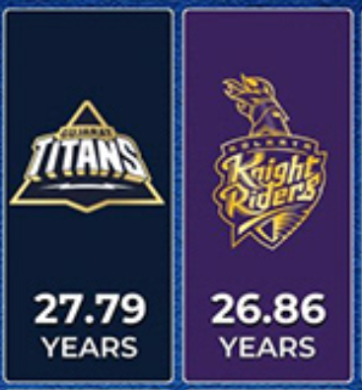
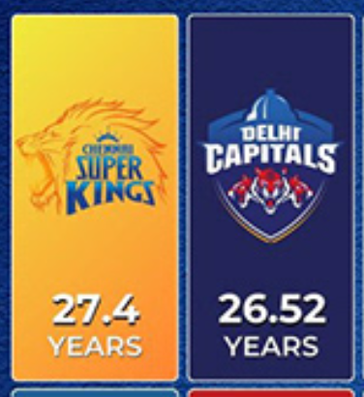
05
EXPLORATORY DATA ANALYSIS
Click here to add content of the text，and briefly explain your point of view.
Player Distribution:
Visualizations showcasing player demographics such as
player base prices, sold prices ,playing role and
team strategies.
Price Distribution:
Analysis of base prices and sold prices distributions,
identifying outliers and trends.
Correlation Analysis:
Insights into factors influencing player valuation,
e.g., playing role,old squad,base price,performance value
Click here to add content of the text，and briefly explain your point of view.

Slide 12
07
MODELS
In our analysis of IPL 2022 auction data, we leverage the powerful capabilities of Python libraries such as NumPy, Matplotlib, and Seaborn to develop insightful models that aid in understanding player valuations, market trends, and team strategies. Here's how we utilize these libraries in our analysis:
Descriptive Statistics with NumPy
Data Visualization with Matplotlib and Seaborn
Regression Analysis with Scikit - Learn
Time Series Analysis with Matplotlib
By integrating these models into our analysis pipeline, we gain a comprehensive understanding of the IPL 2022 auction data, enabling us to derive actionable insights that inform strategic decision-making for IPL franchises. The seamless integration of Python, NumPy, Matplotlib, and Seaborn empowers us to unlock the full potential of the auction dataset and drive value for stakeholders in the cricketing ecosystem.

Slide 13
01
02
03
04
Descriptive Statistics with NumPy
Data Visualization with Matplot and Seaborn
Regression Analysis with Scikit- Learn
Time Series Analysis with Matplotlib
Objective:
To compute descriptive statistics such as mean, median, standard deviation, and quartiles for key auction parameters like player prices, age, and performance metrics.
Approach:
Utilizing NumPy's array-based operations and statistical functions, we perform comprehensive analyses to summarize and understand the distribution and variability of auction data.
Objective:
To visually explore and
communicate patterns, trends, and
relationships within the auction
dataset.
Approach:
Matplotlib and Seaborn
offer a plethora of visualization
techniques, including histograms,
box plots, scatter plots, and
heatmaps. These libraries enable us
to create informative and visually
appealing plots that highlight key
insights such as price distributions,
correlation between player attributes,
and temporal trends in auction
dynamics.
Objective:
To build predictive models that estimate player prices based on relevant attributes such as age, performance metrics, and playing role.
Approach:
We may utilize Scikit-Learn, a machine learning library compatible with NumPy, to implement regression algorithms such as linear regression or random forest regression. These models can provide valuable insights into the factors driving player valuations and assist teams in formulating bidding strategies.
Objective:
To analyze temporal trends and seasonality in auction prices over the course of the IPL 2022 auction.
Approach:
Matplotlib's time series plotting capabilities enable us to visualize price fluctuations over time, identify patterns such as peak bidding periods, and assess the impact of external factors such as player performance or team strategies on auction dynamics.
03

Slide 14
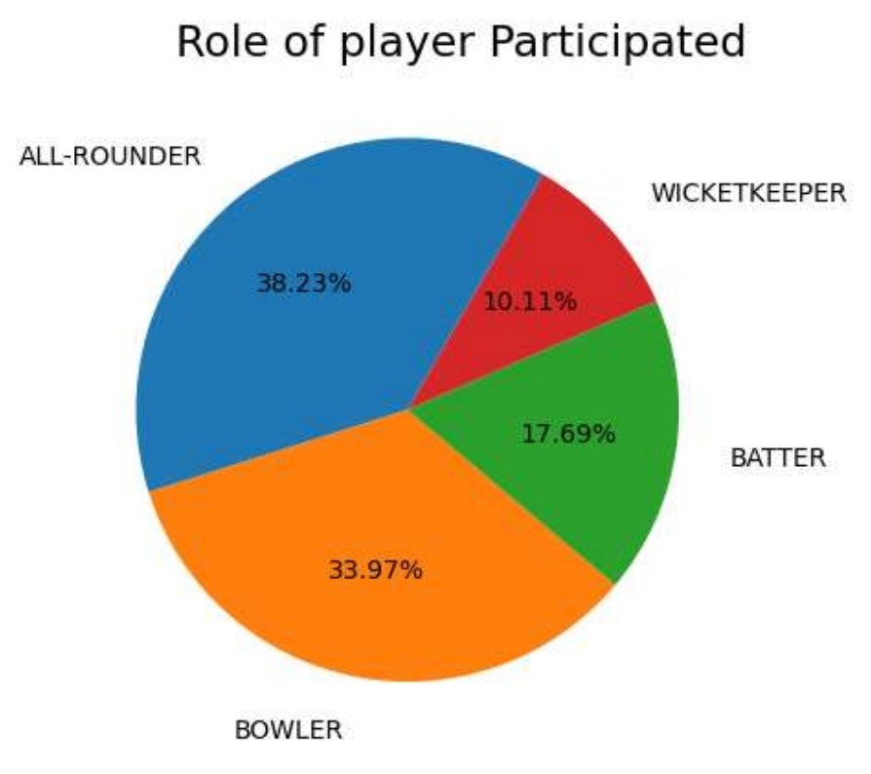
08
GRAPH STUDY
In our analysis of the IPL 2022 auction data, we present a compelling visualization through the intersection graph of a chord diagram, highlighting the distribution of player roles within the tournament. Player roles are categorized into four main categories: batter, bowler, all-rounder, and wicket-keeper.
This visualization offers a succinct yet comprehensive
depiction of the composition of players across different
roles, allowing stakeholders to quickly grasp the balance
and diversity within IPL teams. By visually representing the intersection of player roles, we provide insights into team strategies, positional strengths, and areas for potential recruitment.

Slide 15
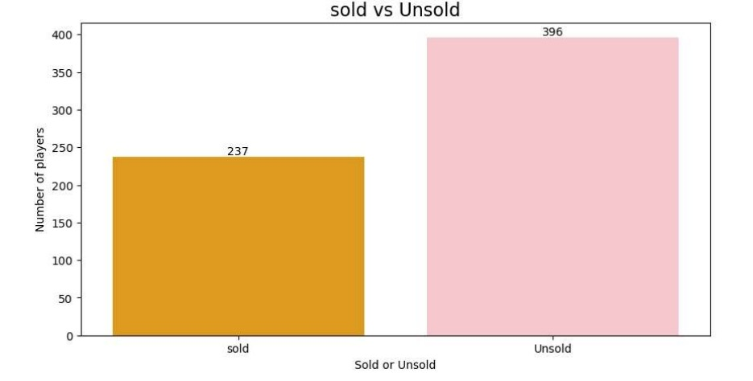
This bar chart illustrates the comparison between sold and unsold players in the IPL 2022 auction. This concise visualization provides a clear understanding of the distribution of players who secured contracts versus those who remained unsold. Through this analysis, we gain insights into market demand, player valuation trends, and team strategies during the auction process. Below is the bar graph showing sold vs unsold players.

Slide 16
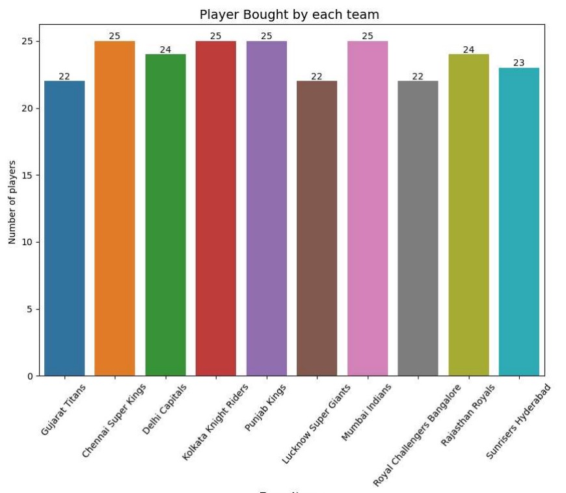
This bar chart presents a succinct overview of the number of players bought by each IPL team during the 2022 auction. This visualization provides valuable insights into team strategies, recruitment patterns, and squad composition. By examining the distribution of players across teams, stakeholders can gain a deeper understanding of each franchise's approach to building their squads for the upcoming IPL season. Below is the bar chart of the player bought by each team.

Slide 17
09
01
In conclusion, the "IPL 2022 Auction Data Analysis Using Python" project has provided valuable insights into the dynamics of the IPL auction process. Through meticulous data collection, preprocessing, and analysis, we have uncovered trends, patterns, and factors influencing player valuations that are instrumental in shaping team strategies.Our analysis has shed light on various aspects of the auction, including player demographics, price distributions, bidding strategies, and temporal trends. We have identified key drivers of player prices, such as performance metrics,, playing roles, providing actionable insights for IPL franchises to optimize their squad compositions.Moreover, by leveraging Python's robust data analysis libraries such as NumPy, Matplotlib, and Seaborn, we have demonstrated the power of data-driven decision-making in the realm of professional sports. These tools have enabled us to perform comprehensive exploratory data analysis, visualize complex datasets, and even build predictive models to forecast player prices.
CONCLUSION
02
As we reflect on the outcomes of this project, it is evident that data analytics plays a pivotal role in enhancing the strategic capabilities of IPL teams. By embracing data-driven approaches, franchises can gain a competitive edge, maximize resource utilization, and ultimately increase their chances of success on the cricketing field.Moving forward, the insights generated from this analysis can serve as a foundation for further research, refinement of models, and continuous improvement in decision-making processes. We remain committed to advancing the field of sports analytics and contributing to the evolution of the IPL ecosystem through data-driven innovation.In closing, we extend our gratitude to all stakeholders involved in this project and express our optimism for the future of data-driven sports management in the IPL and beyond.

Slide 18
THANK YOU

